Slide 1



Slide 2
TEACHER NAME :
Konica Rani
Assistant teacher
Dukhen Tarkey Govt. primary school
Matlob Uttar.Chandpur.

Slide 3

Class -1
Subject: English
Unit: 21
Lesson –(1-3)

Slide 4
Learning Outcome : .
1.Students able to say Rhyme Counting Cats
2student’s will be able to write number (1. 2 .3 . 4)

Slide 5
Good Morning…………………
Good Morning , Good Morning
How are you Today ?
I am fine I am fine.
I wish you a good day.

Slide 6
Lesson Declaration:
Counting cats.

Slide 7
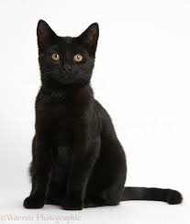
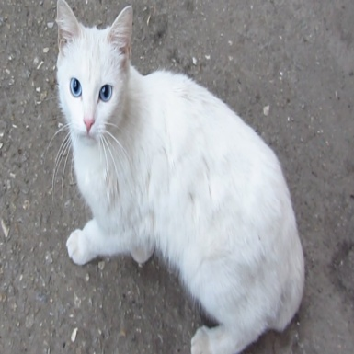
1
1Black Cat.
2
2 white Cat.

Slide 8
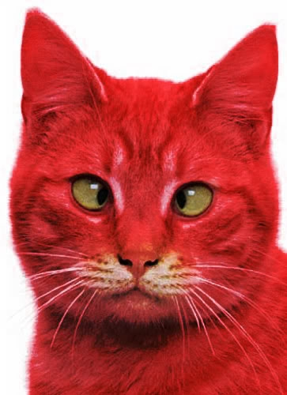
3Red cat
3

Slide 9
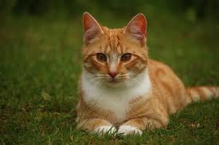
4 Brown cat .
4

Slide 10
Black Cat.
White Cat.
Rat Cat .
Brown Cat .

Slide 11

Presentation.
1
2
3
4
one
two
three
four

Slide 12
Counting .
One
1
Two
2
Three
3
Four
4

Slide 13
Counting picture matching the numbers
two
four
one
Three

Slide 14
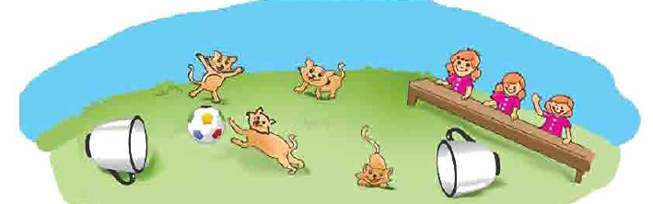

Counting cats

Slide 15
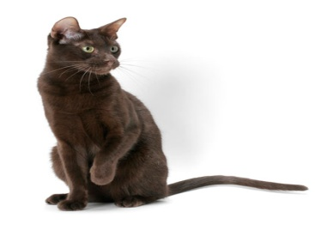
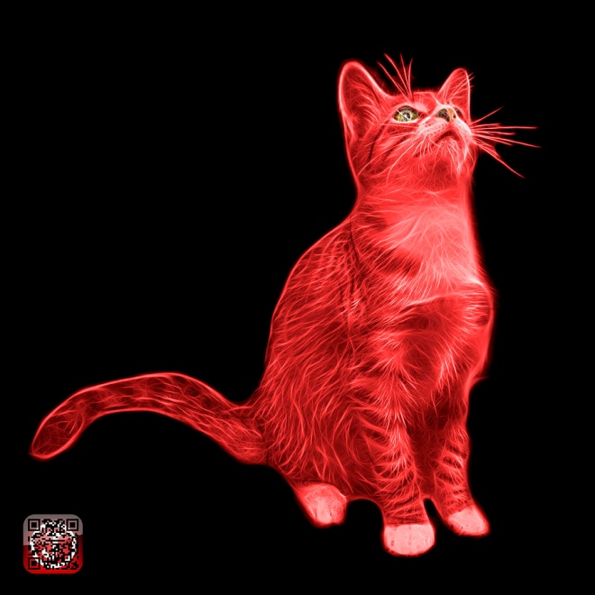
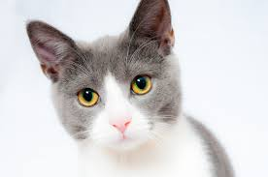
How many picture write down in the number

Slide 16
Home work
What is this ?
cat

Slide 17

Thank You All
See You Again

